Slide 1
EAS
Criteria for Activation
Adrienne Abbott Gutierrez
Nevada EAS Chair

Slide 2
EAS ACTIVATIONS
How do you know when to issue an EAS activation?

Slide 3
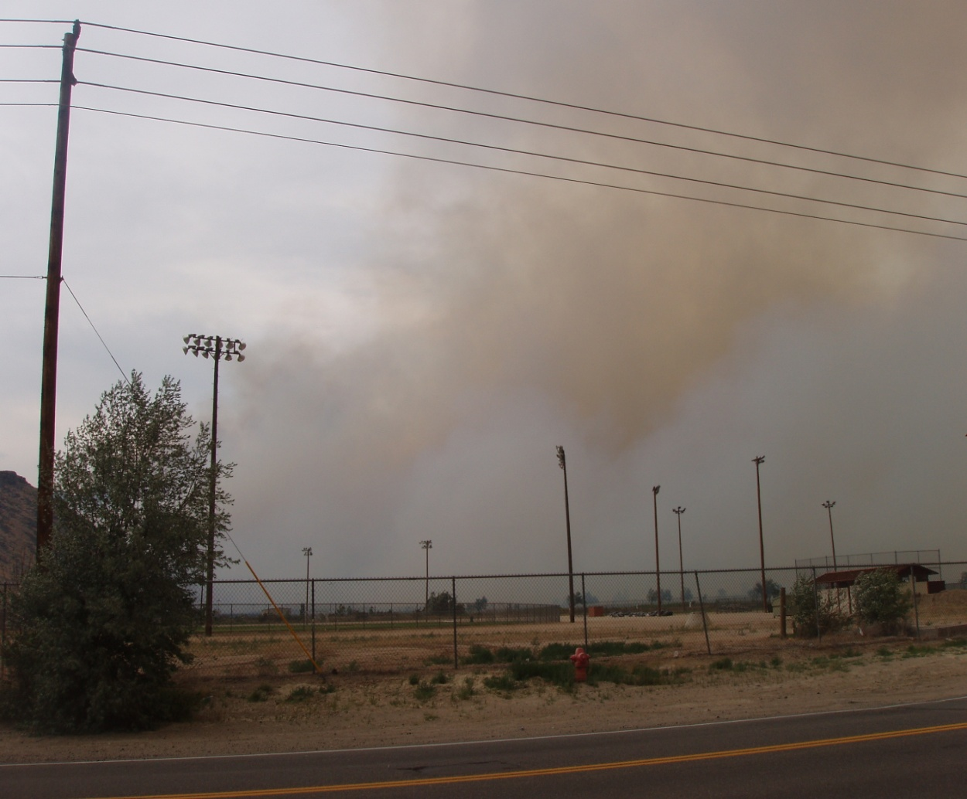
Significant threat to lives or property
Lineham Fire
Carson City
July 2006
Notes:
To use the EAS, there must be a significant threat to lives or property.

Slide 4
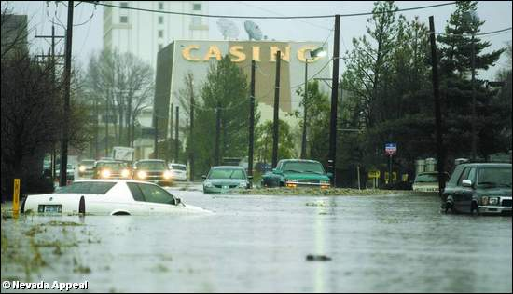
Threat must be defined
Carson City New Year’s Flood 2006
Notes:
The threat must be defined—in other words, you can say what it is: a flood, a fire, a chemical spill. The threat has a name.

Slide 5
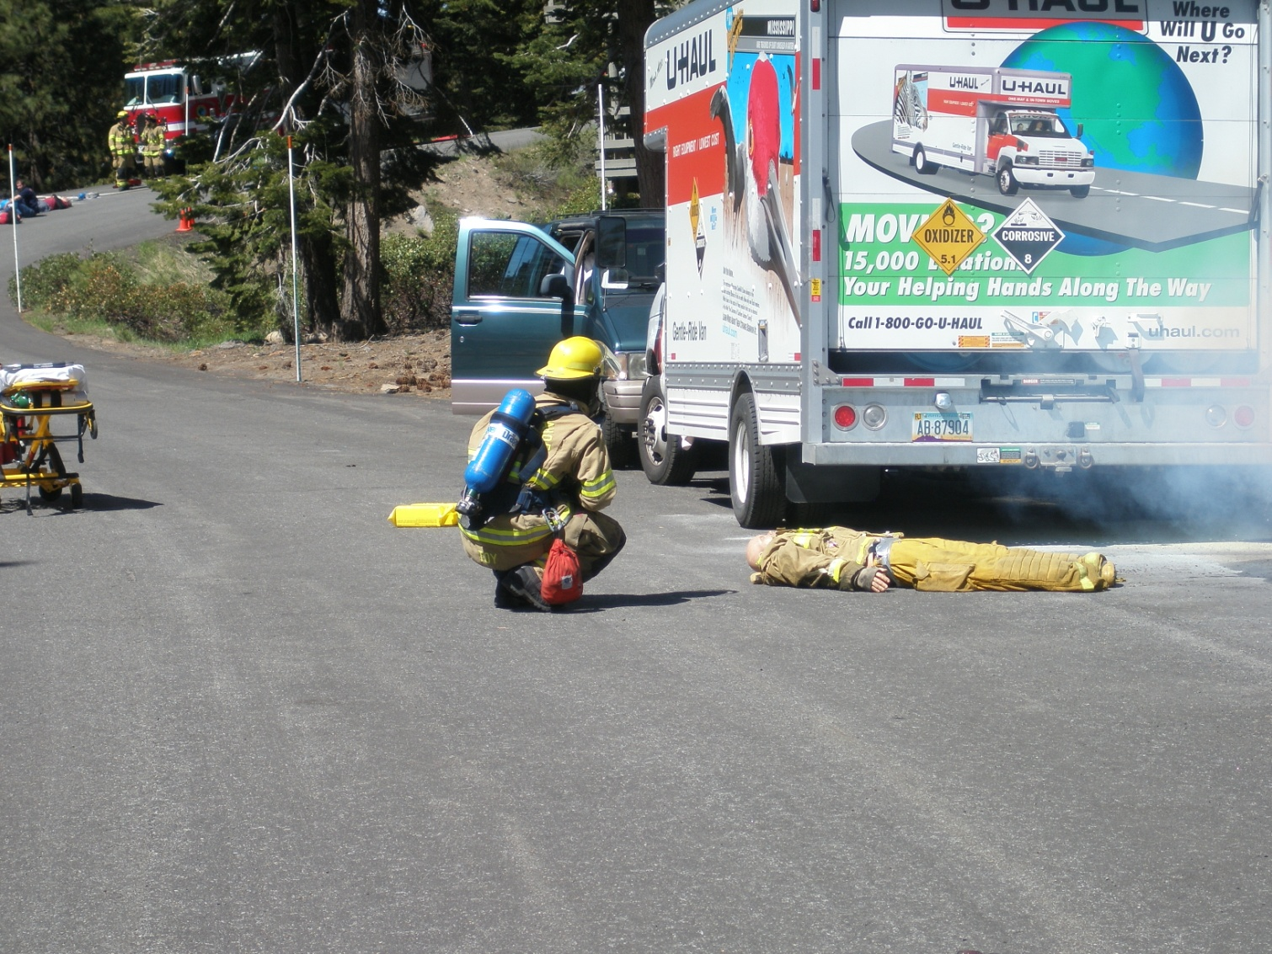
Threat must have a time element
Incline Village Disaster Drill
May 2007
Notes:
In addition, there is a time element involved in the threat. It’s immediate, like a tornado or fire, or in the case of a chemical or radioactive cloud that may be two hours away from a community, you’re going to need every second of those two hours to prepare people for the threat arrival.

Slide 6




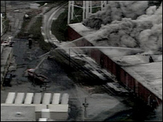
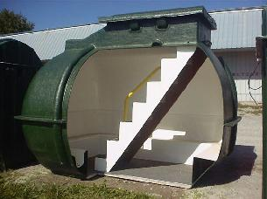
Specific action must be defined
Notes:
You must have something you want people in the threat area to do, even if it’s just get out. You may not be able to tell people specifically what roads to use but the most important thing for them to do immediately is to leave their homes or offices. Get that information to the public immediately and follow up in later broadcasts with specific road information or evacuation shelter locations. You won’t have many cases where you will know everything about an evacuation situation at the time you need to be telling people to get out.

Slide 7
EAS CRITERIA
Other reasons for issuing an EAS activation:

Slide 8

New information
Updates
Cancellation
  No activation
  All Media
Return conditions
Mitigation
Notes:
Let people know that you will provide them with new or additional information or when the threat is over and they can return to their homes or offices.

Slide 9

EAS WARNINGS
How are EAS activation messages issued?
  CAP
  Legacy EAS
Notes:
After you decide you need to issue an EAS activation, what do you do next? Your agency and community should have a Public Warning/Public Information Plan.

Slide 10
CAP EAS ACTIVATIONS
Software only
Recorded message
  Add as a Wave file
  Text included
Text to Speech
Add maps, graphics, photos
CAP Software sends the activation directly to broadcasters and others

Slide 11
CAP EAS ACTIVATIONS
MyStateUSA Software

Slide 12
CAP EAS ACTIVATIONS
CAP EAS Activations include broadcast and cable
CAP EAS Activations can also be sent to cell phones (WEA)and other CAP compliant Internet-based systems
CAP EAS Activations can turn on sirens and signs

Slide 13
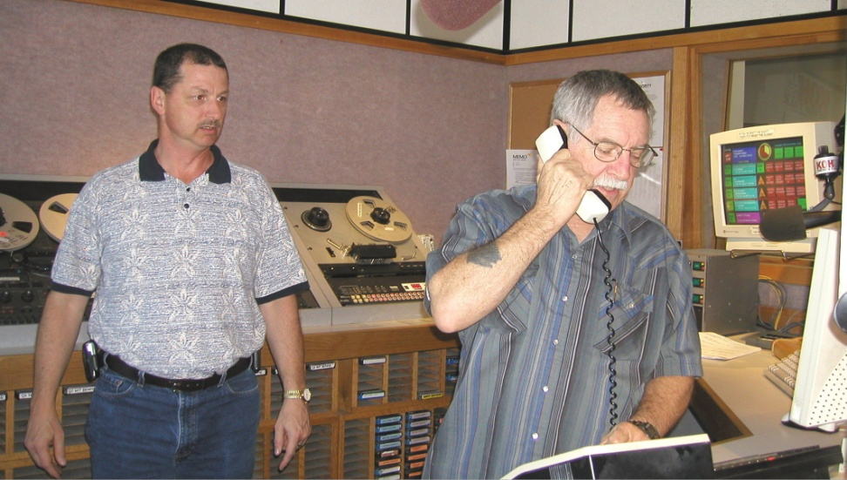
LEGACY EAS ACTIVATIONS
What to do when the Internet isn’t there…
Contact the Local Primary Station
Record activation message
Provide activation information

Slide 14
LEGACY EAS ACTIVATIONS
Local Primary 1 station broadcasts the activation
LP-1 STATION
Notes:
The LP-1 station broadcasts the activation...

Slide 15
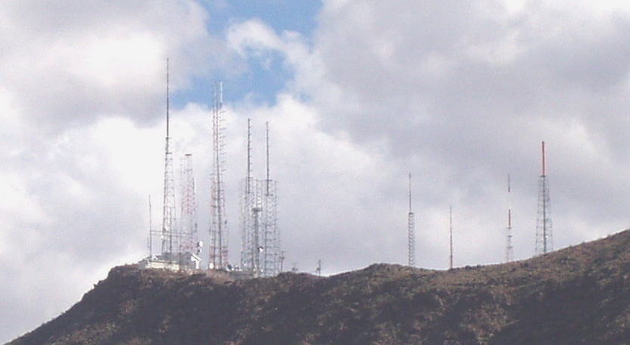
Participating stations receive activation
Participating stations rebroadcast activation
Notes:
...and the participating stations receive the activation. The participating stations then rebroadcast the activation within 15 minutes.

Slide 16
The audience hears the emergency information and takes appropriate action.
Notes:
Listeners and viewers hear the distinctive "duck quacks" of the digital signal, then the alert tone, followed by the emergency information. Most people will then take the appropriate action although the first reaction from some will be to call 9-1-1 for more information.

Slide 17
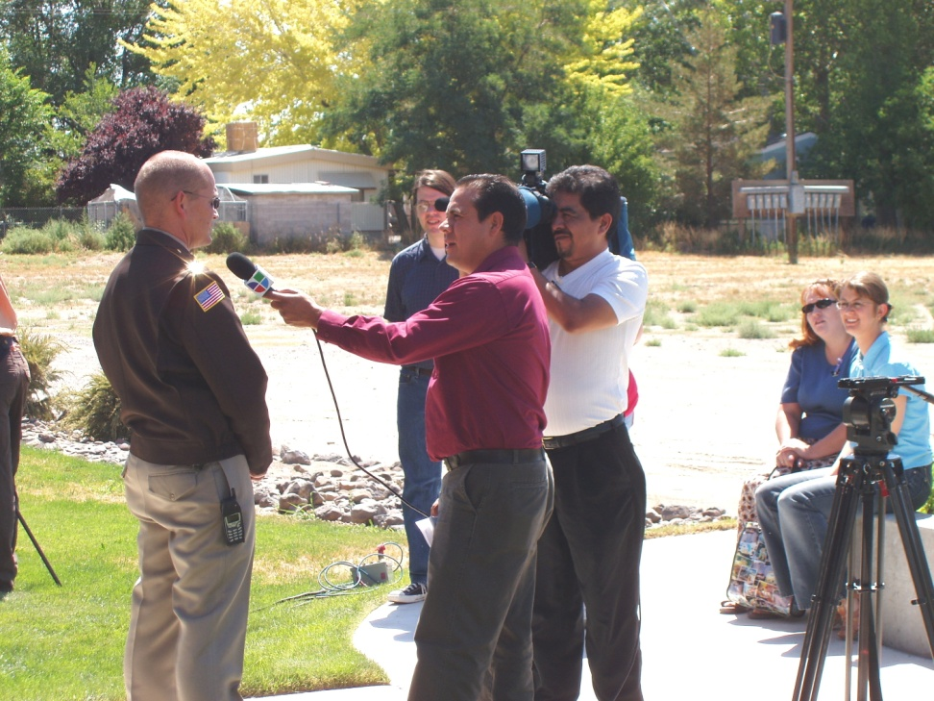
EAS ACTIVATIONS
Designate a Public Information Officer
PIO should have no other function
PIO deals with media inquiries and needs
PIO handles rumour control

Slide 18
QUESTIONS
?

